Slide 1
Waste Water Treatement Based on Plasma Technology
SL NO. | NAME | USN
1. | CHETHAN D | 01JST20EE008
2. | VARSHAN C R | 01JST20EE056
3. | SINDHU K M | 01JST20EE047
4. | PRIYANKA M | 01JST20EE062

Slide 2
Introduction
The Fourth State of matter. Ionised gas consisting of positively and negatively charged ion, free electrons and activated neutral species.
A mixture of Electrons, Ions, Neutral Particles. Ions and neutral particles have much higher mass than electrons.
Some of the these particles are in excited state. Photon Emission takes place when these particles return from excited state to neutral state. It is responsible for luminosity of plasma.

Slide 3
Current Waste Water Disinfection Methods and their Problems
Chlorination:
Continuously adding chlorine to system
Toxic to aquatic life and may require dechlorination
Safety Hazards
High Cost
Ultraviolet Light(UV):
Cloudy water will shield organism from light
Organisms sometimes are able to repair damaged DNA
Not as cost effective as chlorination
Ozonation :
Just produces Ozone
Long treatment time

Slide 4
Literature Survey
Sl No. | Title and Author | About the Paper | Scope of implementation
1 | Plasma-Activated Water: An Alternative Disinfectant for Drinking Water Treatment by Chen, Y. and Bruggen, B.V | This research paper reviews the use of plasma-activated water (PAW) for drinking water treatment, highlighting the generation of reactive species that can oxidize and degrade contaminants. It discusses the effectiveness of PAW in removing various contaminants such as pharmaceuticals, pesticides, and bacteria from drinking water sources | The scope of implementation includes using PAW as an alternative disinfectant for drinking water treatment, particularly in areas where conventional disinfection methods may not be effective or sustainable. Further research is needed to optimize plasma generation methods and ensure long-term performance and safety of PAW in drinking water treatment systems.

Slide 5
Sl No. | Title and Author | About the Paper | Scope of implementation
2. | Plasma Water Purification for Water Reclamation: Progress and Challenges by Fidalgo, B., Morin, G., et al. | This research paper discusses the progress and challenges of plasma water purification for water reclamation, focusing on the use of PAW in removing contaminants from recycled water for reuse in non-potable applications. It highlights the potential of PAW in improving water quality for agricultural irrigation and industrial processes, and the challenges associated with energy consumption and byproduct formation. | The scope of implementation includes using PAW for water reclamation purposes, particularly in applications where recycled water is used for non-potable purposes such as agricultural irrigation and industrial processes. Further research is needed to optimize energy efficiency, minimize byproduct formation, and ensure the reliability and consistency of plasma water purification systems in water reclamation settings.

Slide 6
Sl No. | Title and Author | About the Paper | Scope of implementation
3. | Plasma Water Purification for Wastewater Treatment: Current Status and Future Perspectives by Fidalgo, B., Morin, G., et al. | This research paper provides an overview of the current status and future perspectives of plasma water purification for wastewater treatment. It discusses the potential of plasma-activated water (PAW) in reducing organic pollutants, pathogens, and nutrients in wastewater, and its use as a pre-treatment or post-treatment step in combination with other technologies. Challenges such as energy consumption and byproduct formation are also highlighted. | The scope of implementation includes using PAW as a potential technology for wastewater treatment to remove contaminants and improve water quality. Further research is needed to optimize energy efficiency, mitigate byproduct formation, and evaluate the long-term performance and stability of plasma water purification systems in real wastewater treatment scenarios.

Slide 7
Problem Statement
Plasma water purification, an alternative to chlorination and UV treatment, may overcome their limitations, enhancing contaminant elimination for safer drinking water. Its efficiency assessment against traditional methods is crucial to determine its viability in water treatment processes, addressing drawbacks to potentially emerge as a promising solution.

Slide 8
Objectives
To setup the Plasma chamber.
To purify water using high voltage plasma.
To ensure the safety of operation.

Slide 9
Suggestions Given by panel members
Try Different Converters and Check
Only Design Reactor, not the full Filter
Take Safety Measures.

Slide 10
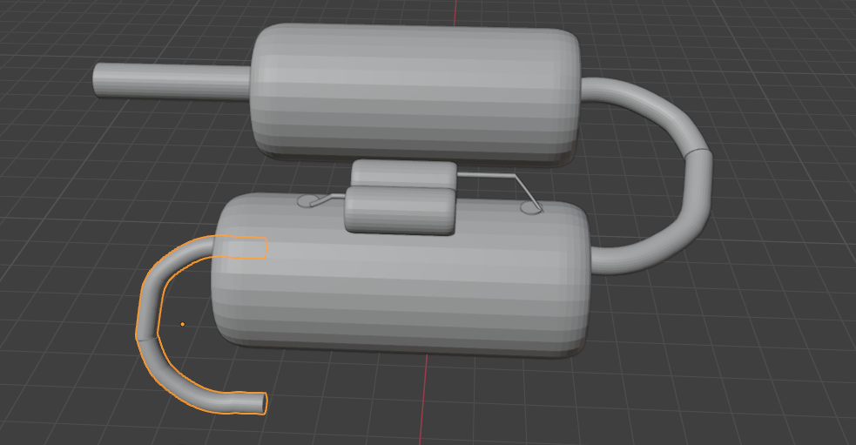
Simulation of Reactor

Slide 11
Advantages of Plasma
Compact and Require less Space
Less Chemicals
Higher throughput
Lower sludge
Reduce odor and color
Support for mobile unit
Lower Operating and Maintainance Cost
Promote Green Technology and Environment

